Slide 1
Jing Yi, Dianna Tran, Shiyun Jiang, Molly Ingram, Miguel Gómez, Pat Canning, Jeff Bloem and Chris Barrett ASTAR workshop USDA headquarters, Washington, DC July 26, 2023
Several stylized facts about how agri-food value chain employment and compensation changes with structural transformation
The VERY PRELIMINARY findings and conclusions in this presentation are those of the authors and should not be construed to represent any official USDA or U.S. Government determination or policy. This research was funded in part through Cooperative Agreement number 58-4000-1-0080 between Cornell University and the U.S. Department of Agriculture Economic Research Service.

Slide 2
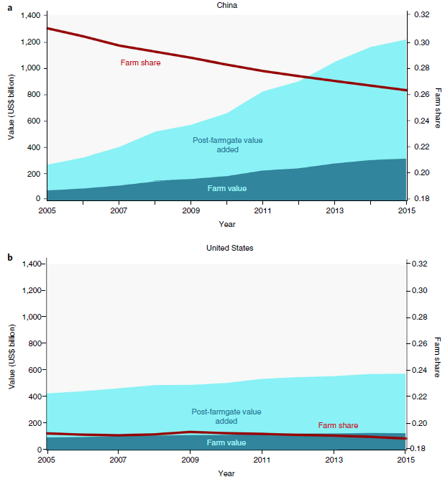
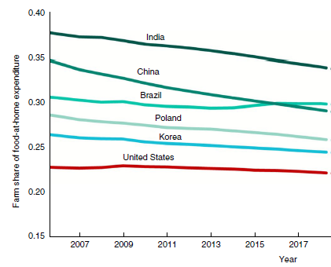
Motivation
Usual structural transformation narrative concerns the relative decline of agriculture.
But as incomes grow, consumers demand more convenience, quality, safety, variety, etc. and farm share of consumer food expenditures falls (Yi et al. Nature Food 2021; Barrett et al. J.Econ.Lit 2022)
Source: Yi et al. (Nature Food 2021)

Slide 3
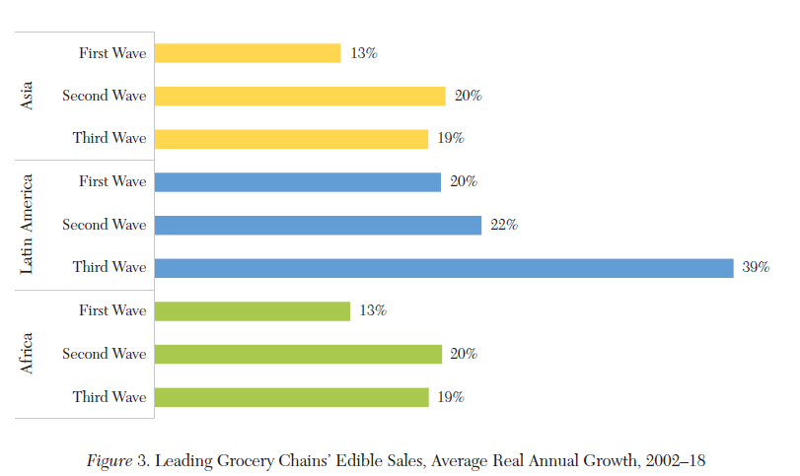
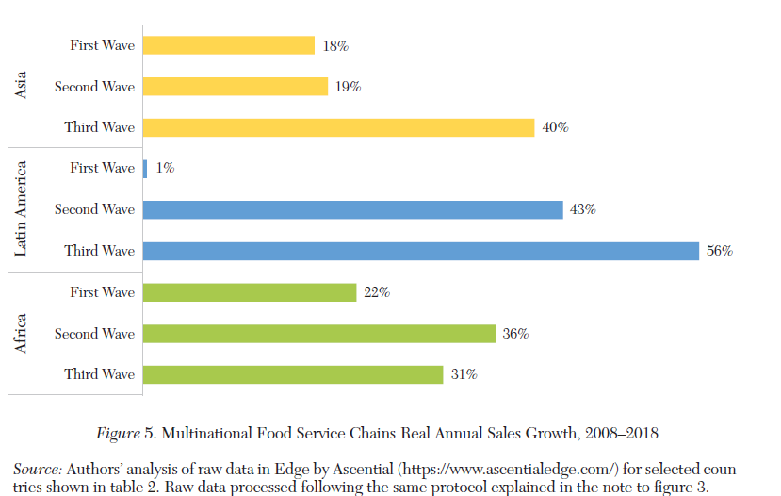
Motivation
The downstream shift in value addition towards consumer-facing AVC segments (retail and food service) is mirrored in firm growth rates.
LMIC grocery stores LMIC MNC food service
Source: Barrett et al. (J. Econ. Lit. 2022)
Given downstream shift in value addition, what happens to employment/compensation across AVC?

Slide 4
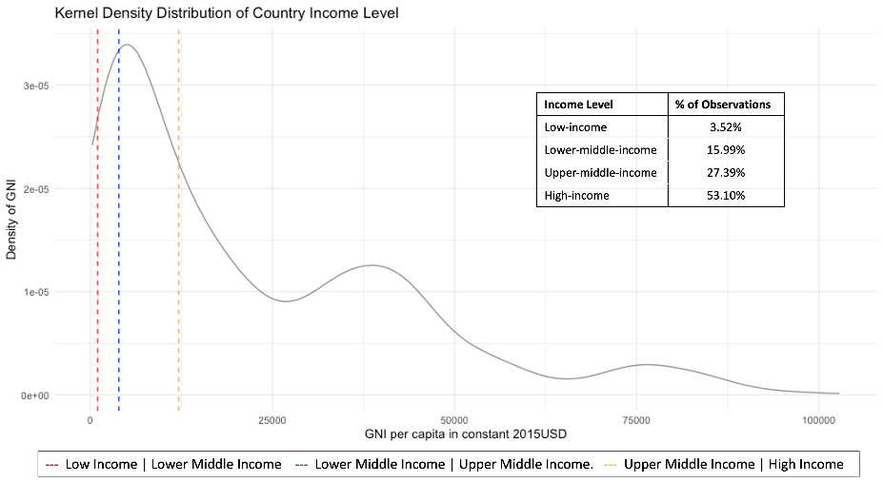
Workflow
Build on Global Food Dollar method (Yi et al. Nature Food 2021) and USDA ERS’ Food Dollar factor and industry decomposition methods.
Use EORA MRIO data 1990-2021 for 189 countries.
Break into six AVC industries: 1) Primary production, 2) Processing, 3) Transportation and storage, 4) Wholesale, 5) Retail, 6) Food service.
Generate factor decompositions to isolate labor compensation
Process ~3 billion data points per year x 28 years. N>80 billion!!!
Then match with SITC-specific ILO labor data (15+ yo, primary F-T job)
Yields 131 countries in an
uneven panel from 1993-2021
7) Uneven coverage across income levels
[Note: we’re still processing data, so today will present preliminary results using the 94 countries in the 1995, 2000, 2005, 2010, 2015 and 2020 data.]

Slide 5
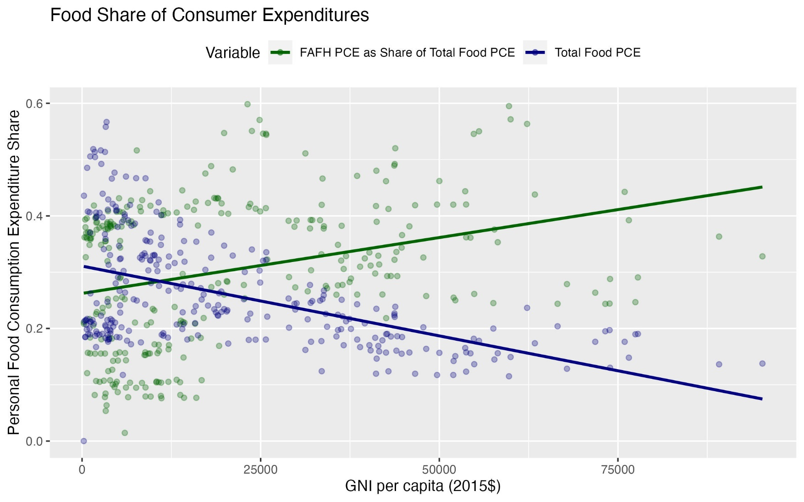
Stylized facts
1. Food share of consumer expenditures falls and shifts toward FAFH as incomes rise.

Slide 6
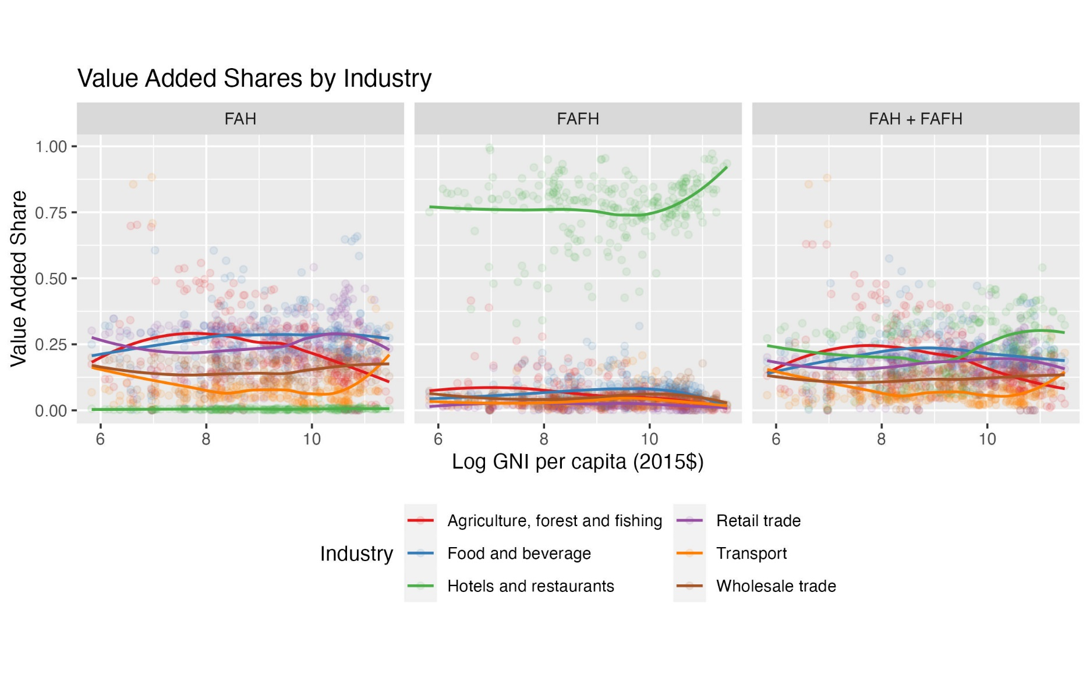
Stylized facts
2. Value addition patterns differ b/n FAH and FAAFH and exhibit different evolution w/income growth.
Note: LIC ~<7
LMIC [7,8.4]
UMIC [8.4,9.5]
HIC >9.5
Primary production (AFF) share falls steadily after LIC stage, while food service rises relatively sharply in HIC stage.

Slide 7
Stylized facts
3. Food service most labor intensive of AVC industries.
Labor share of value added lowest in AFF (primary production), highest in food service, retail and transport.
Labor share of value added rises over UMIC/HIC range.
Note: LIC ~<7, LMIC [7,8.4], UMIC [8.4,9.5], HIC >9.5

Slide 8
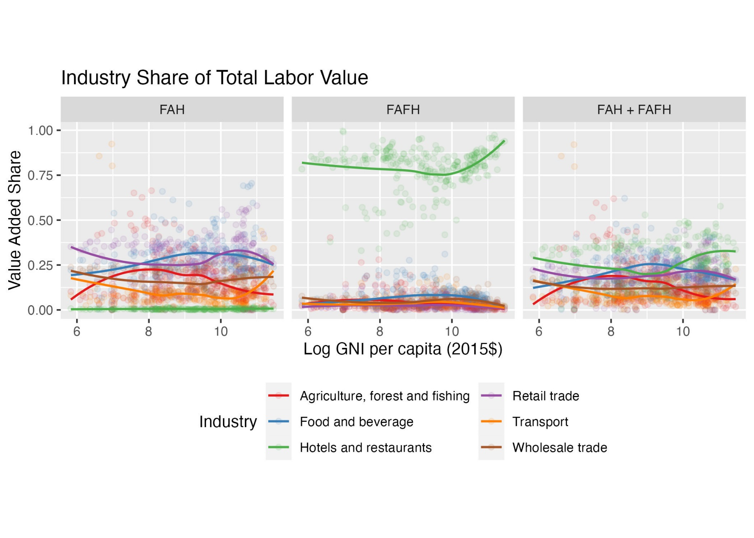
Stylized facts
4. Industry share of AVC labor value addition patterns differ b/n FAH and FAAFH and as incomes rise.
Note: LIC ~<7
LMIC [7,8.4]
UMIC [8.4,9.5]
HIC >9.5
Primary production is never a plurality of AVC labor VA. Food service labor VA highest over LIC/LMIC/HIC range.

Slide 9
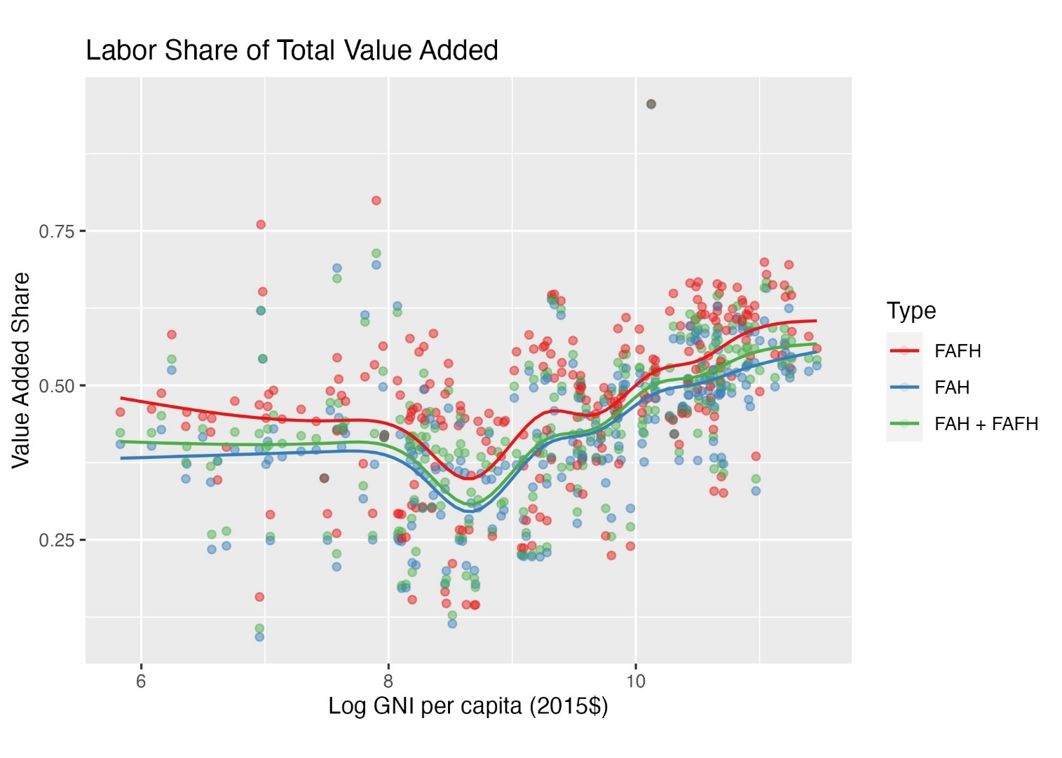
Stylized facts
5. Labor share of total AVC value addition rises as countries reach the UMIC-HIC range. FAFH is more labor intensive than FAH.
Note: LIC ~<7
LMIC [7,8.4]
UMIC [8.4,9.5]
HIC >9.5

Slide 10
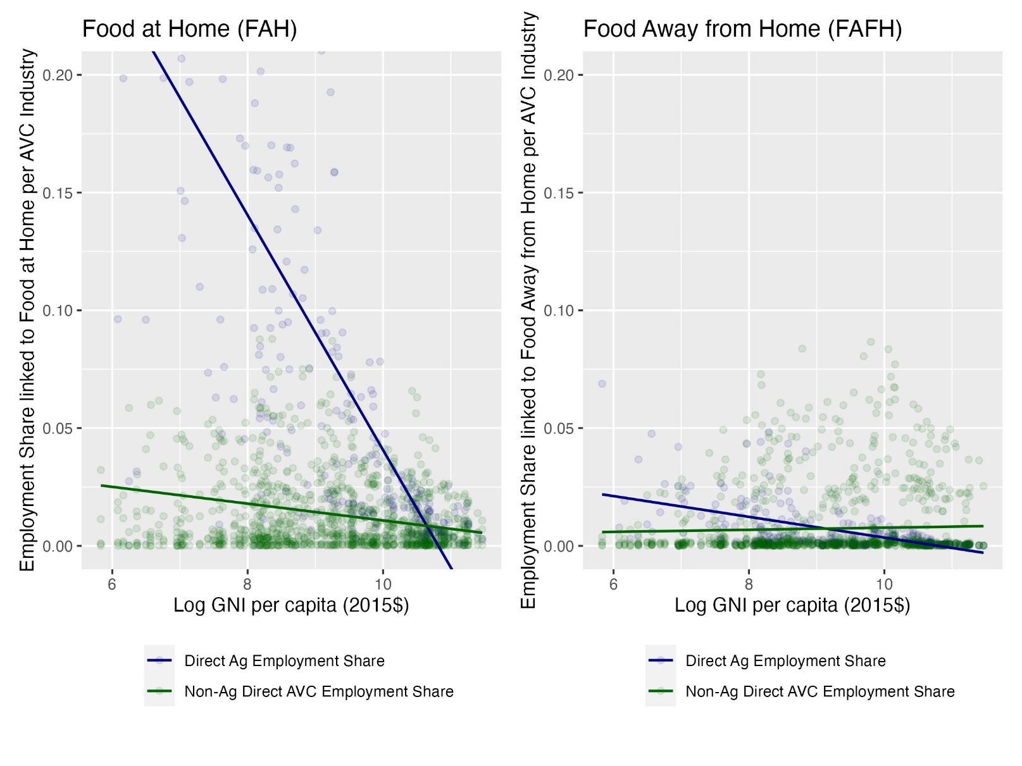
Stylized facts
6. While primary production employment falls as % total jobs in economy, non-ag shares fairly stable.
Note: LIC ~<7, LMIC [7,8.4], UMIC [8.4,9.5], HIC >9.5

Slide 11
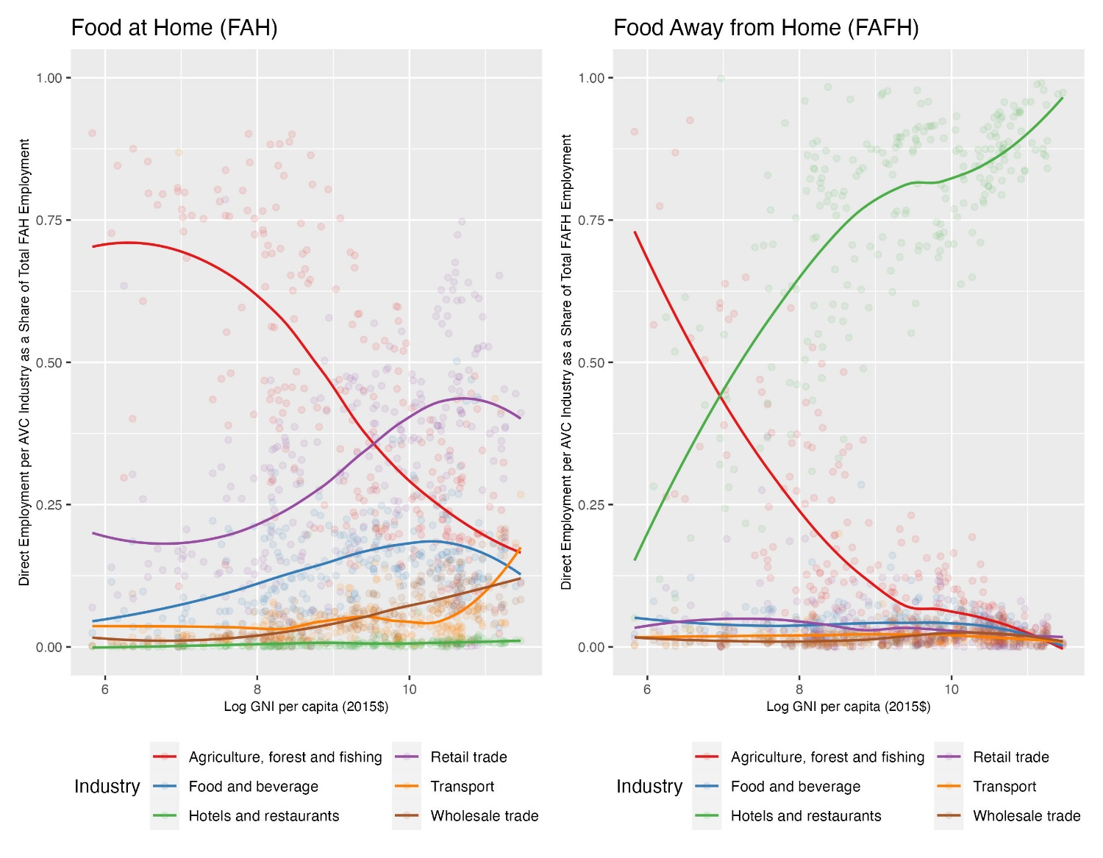
Stylized facts
7. AVC employment growth is mainly driven by growth in FAFH and in the food service industry.
Note: LIC ~<7, LMIC [7,8.4], UMIC [8.4,9.5], HIC >9.5

Slide 12
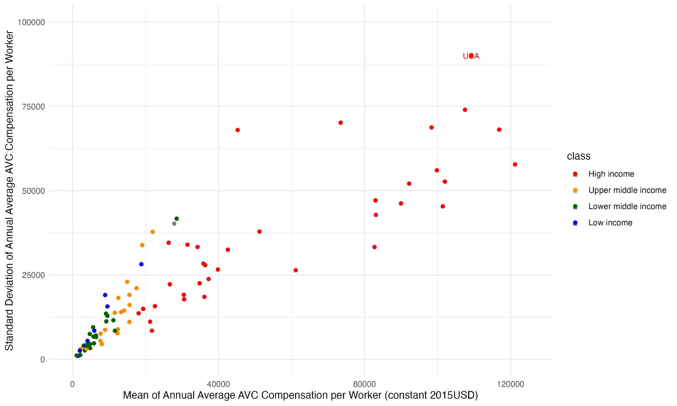
Stylized facts
8. AVC compensation per worker varies a lot, rising sharply with GNIpc. Also greater within-sector inequality as average compensation rises.

Slide 13
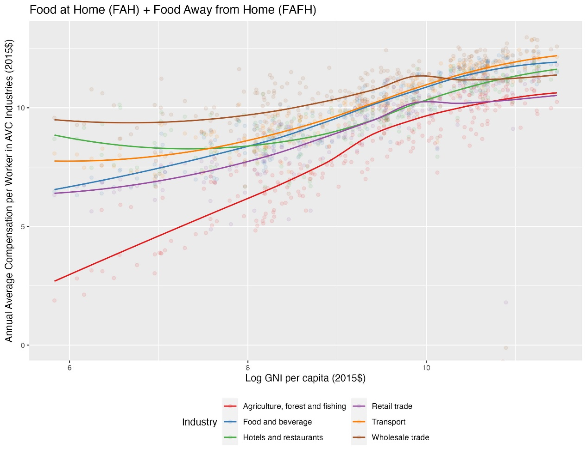
Stylized facts
9. Best compensated AVC jobs are in more capital-intensive industries (manuf/processing, transport, wholesale). Compensation lowest in primary production and retail; but convergence as incomes rise.
Note: LIC ~<7, LMIC [7,8.4], UMIC [8.4,9.5], HIC >9.5

Slide 14
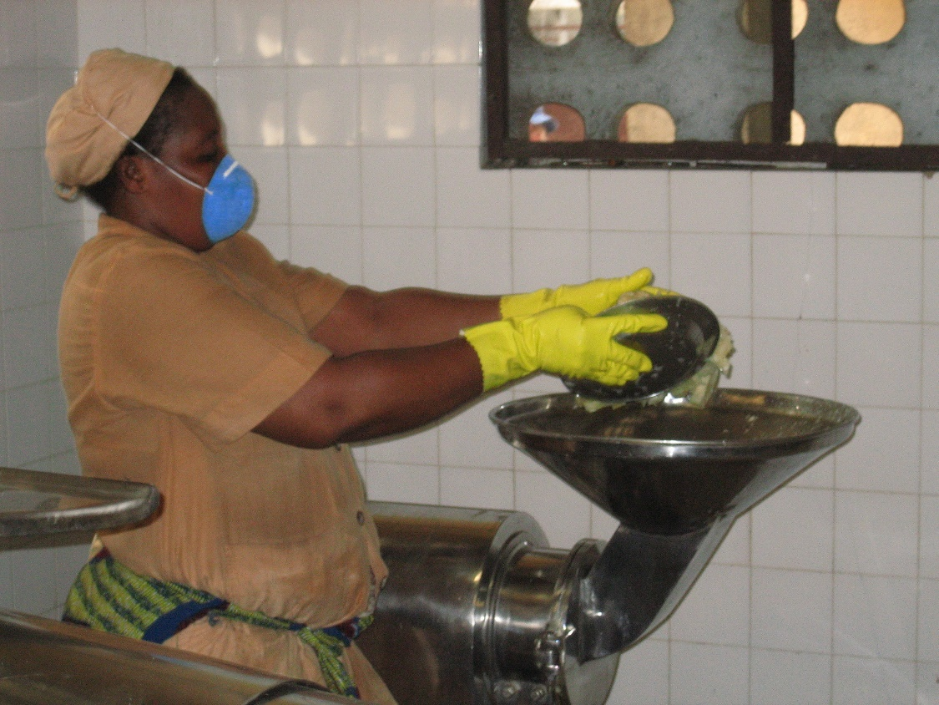
Thank you
Thank you for your time and feedback on these very preliminary results!

